Slide 1
REAL TIME TEXT-TRANSLATION
MENTOR
Dr. Nitesh Naik
TEAM MEMBERS
Rutij Navelkar

Slide 2
INTRODUCTION
Communication is vital in expressing thoughts, ideas and feelings between people. However, when those people do not speak the same language, this communication is ineffective, to say the least.
This language barrier is especially problematic in team efforts in school or college projects and even in high profile jobs.
This is where many people turn to language translation services, in order to translate what is being said, in a language the other person understands this, facilitating effective communication.

Slide 3
PROBLEM STATEMENT
A real-time text translation service that translates text, documents, text in images from English to Konkani, within an accuracy of 0.4 as per BLEU score (Bilingual Evaluation Understudy).
A score of 0.3 to 0.4 would be considered a “understandable to good translations”, 0.4-0.5 being “high quality translations”.
We also aim to provide video captioning for English subtitles into Konkani.

Slide 4
Features
Captioning Service:
Achieve translation of English subtitles in videos to Konkani via closed captions.
Support for Various Formats:
Provide translations for English Text, PDFs and text in images to Konkani.
View Previous Translations:
Users can view their previously translated texts, PDF and images and also download them.

Slide 5
Technologies Used
Python is used due to its versatility and broad choice of libraries and systems for implementing OCR and Video Captioning.
ReactJS is used on the frontend to provide a seamless User Interface that is intuitive and easy to use.
NodeJS for backend, as it is a popular, intuitive and versatile language.
EasyGoogleTranslate API library was used to provide quick, efficient and accurate translations, since processing time is essential especially in the Captioning service.

Slide 6
HARDWARE REQUIREMENTS
Stable and consistent internet connection.
Desktop computer with sufficient processing power to handle the captioning overlays and video playback.
Basic I/O devices ( keyboard, mouse and monitor).

Slide 7
SOFTWARE REQUIREMENTS
Appropriate Operating System for the framework to run on.
Database management systems to store user data, translations.
Web development tools and user interface, as well as debugging tools for testing process.

Slide 8
POSSIBLE CHALLENGES
Ensuring that translation for text happens in real time. Words with multiple meanings or similar-sounding words can cause errors and confusion.
Ensuring proper character encoding is crucial to avoid display issues.
For video captioning it is crucial to identify only the spoken words and not other background noise when generating subtitles.
Also for videos with longer length needs stable internet connection for API to process the video properly.

Slide 9
WHAT HAS BEEN IMPLEMENTED SO FAR
UI Implementation using React JS.
Text translation, PDF and text in Image translation are implemented.
OCR for PDF and Images is implemented using PyTesseract library.
Video Captioning has been implemented with Imagemagick Library which generates an overlay using the translated text and the timestamps of spoken audio. The overlay is then applied to the video, giving closed-captions.
Users can view previously translated text, PDF documents and Images. Options to download and delete have also been provided.

Slide 10
Captioning Implementation
Uses OpenAI’s Whisper for speech recognition from video.
Translates extracted text into Konkani using EasyGoogleTranslate (Unofficial Google Translate API).
Renders translated subtitles as images with Wand (ImageMagick).
Overlays subtitle images onto video using MoviePy.
Exports final video and saves transcripts in both English & Konkani.
Also provides transcripts in both languages for users to download.

Slide 11
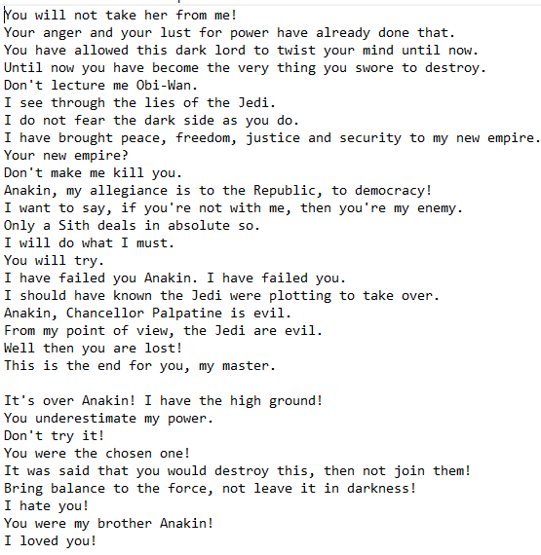
Captioning Example (A transcript from a test video)
This is a transcript generated by the video captioning script.
The input video is a clip from the movie:
Star Wars: Revenge of The Sith

Slide 12
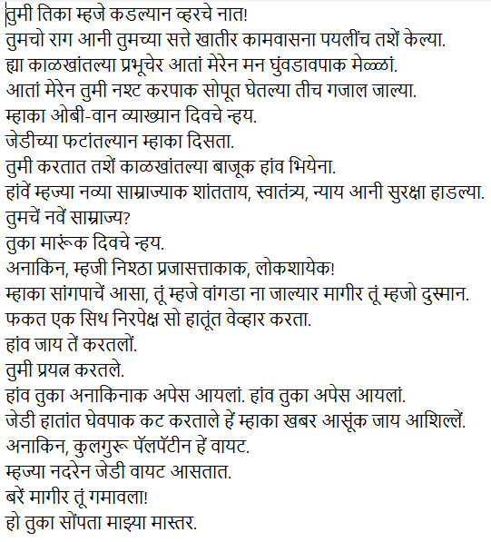
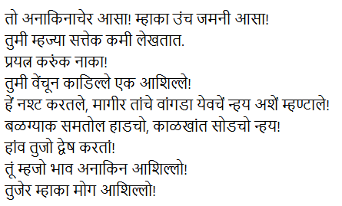
Captioning Example (A transcript from a test video)

Slide 13
Captioning Implementation
The accuracy of translation is depends on the Whisper’s speech recognition and capability of EasyGoogleTranslate API.
Whisper provides 6 model sizes offering speed and accuracy tradeoffs.; “tiny”, “base”, “small”, “medium”, “turbo” and “large”.
Since running on local system, the script uses the “small” model for faster transcription and moderate accuracy. With sufficient RAM larger models can be used.
We can use the “medium” model as well to improve the speech recognition but processing time is increased.
Processing time also depends on resolution of the video.(Currently using 360p faster processing).
Because this entire project is running locally, there may be degradation in accuracy of speech recognition or translation.

Slide 14
Previous Translations
Users can view their previously translated texts, documents and images.
For documents and images users can download the output in docx format.
The currently logged in user sees only his/her translations and not of other users.
An option to delete is also provided if users wish to delete any of the translations.
To store the translation, the project uses a MySQL via phpMyAdmin.

Slide 15
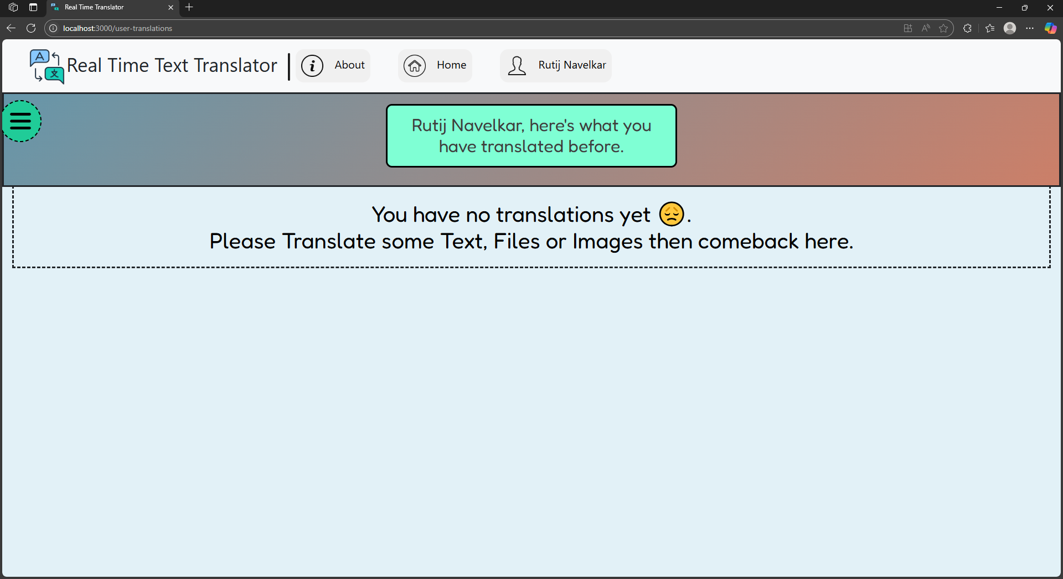
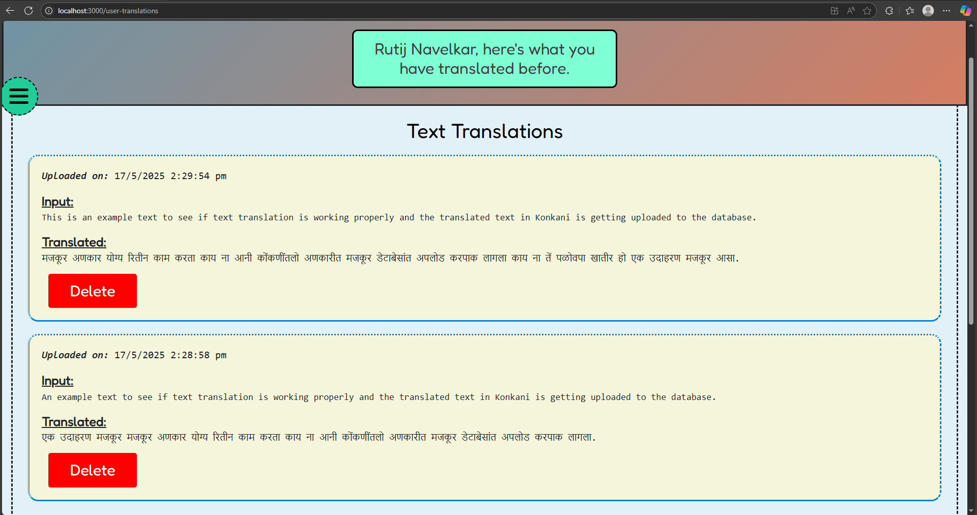
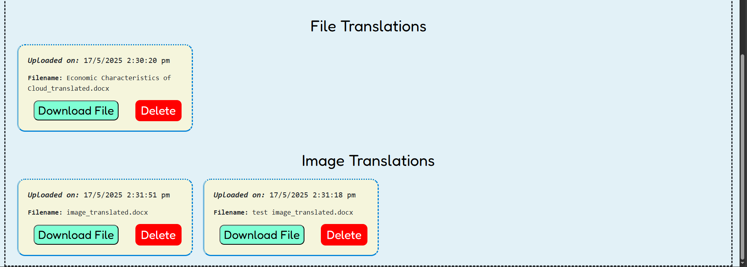
Previous Translations

Slide 16
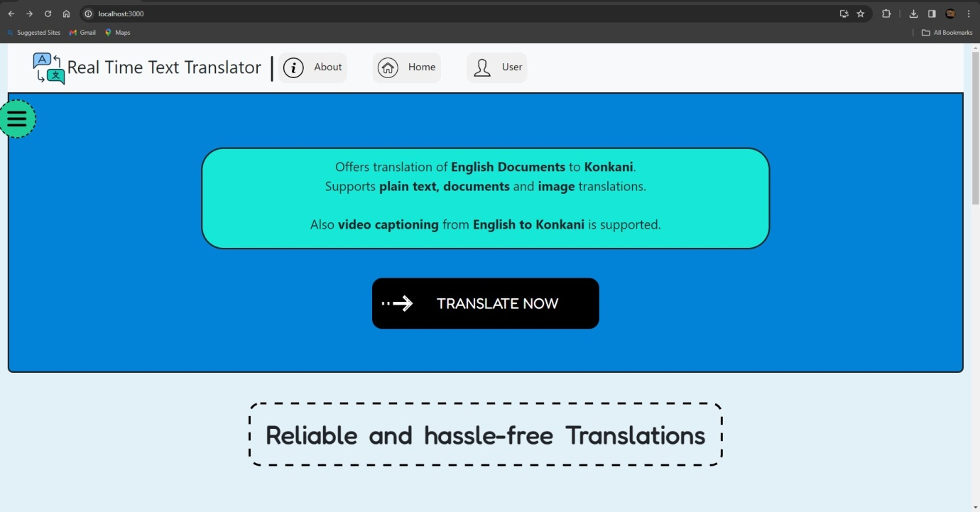
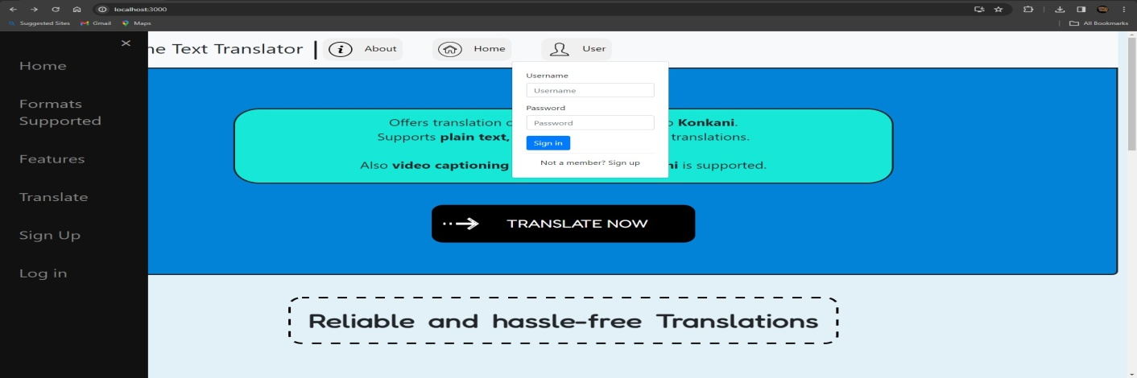
UI Implementation

Slide 17
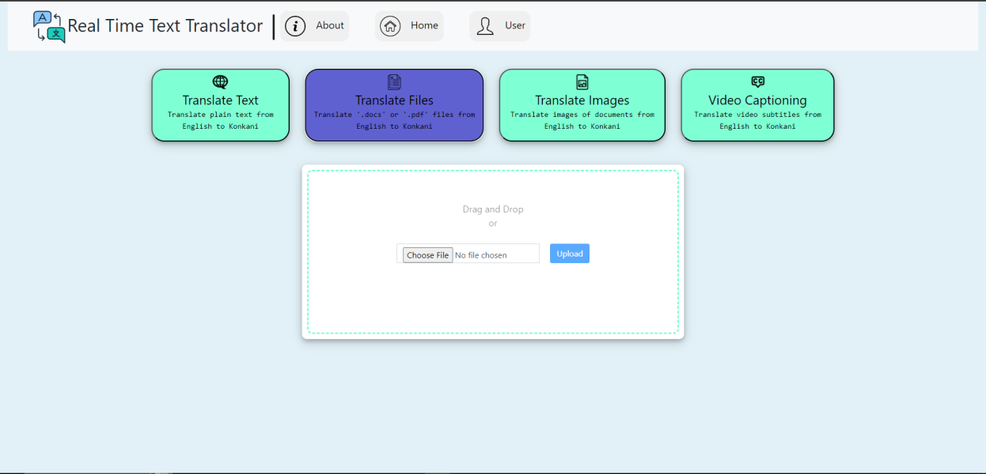
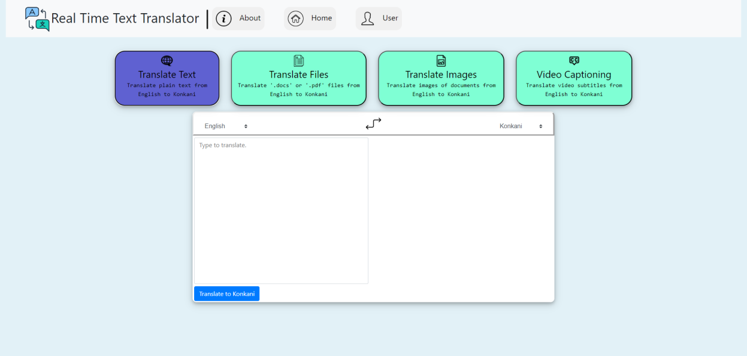
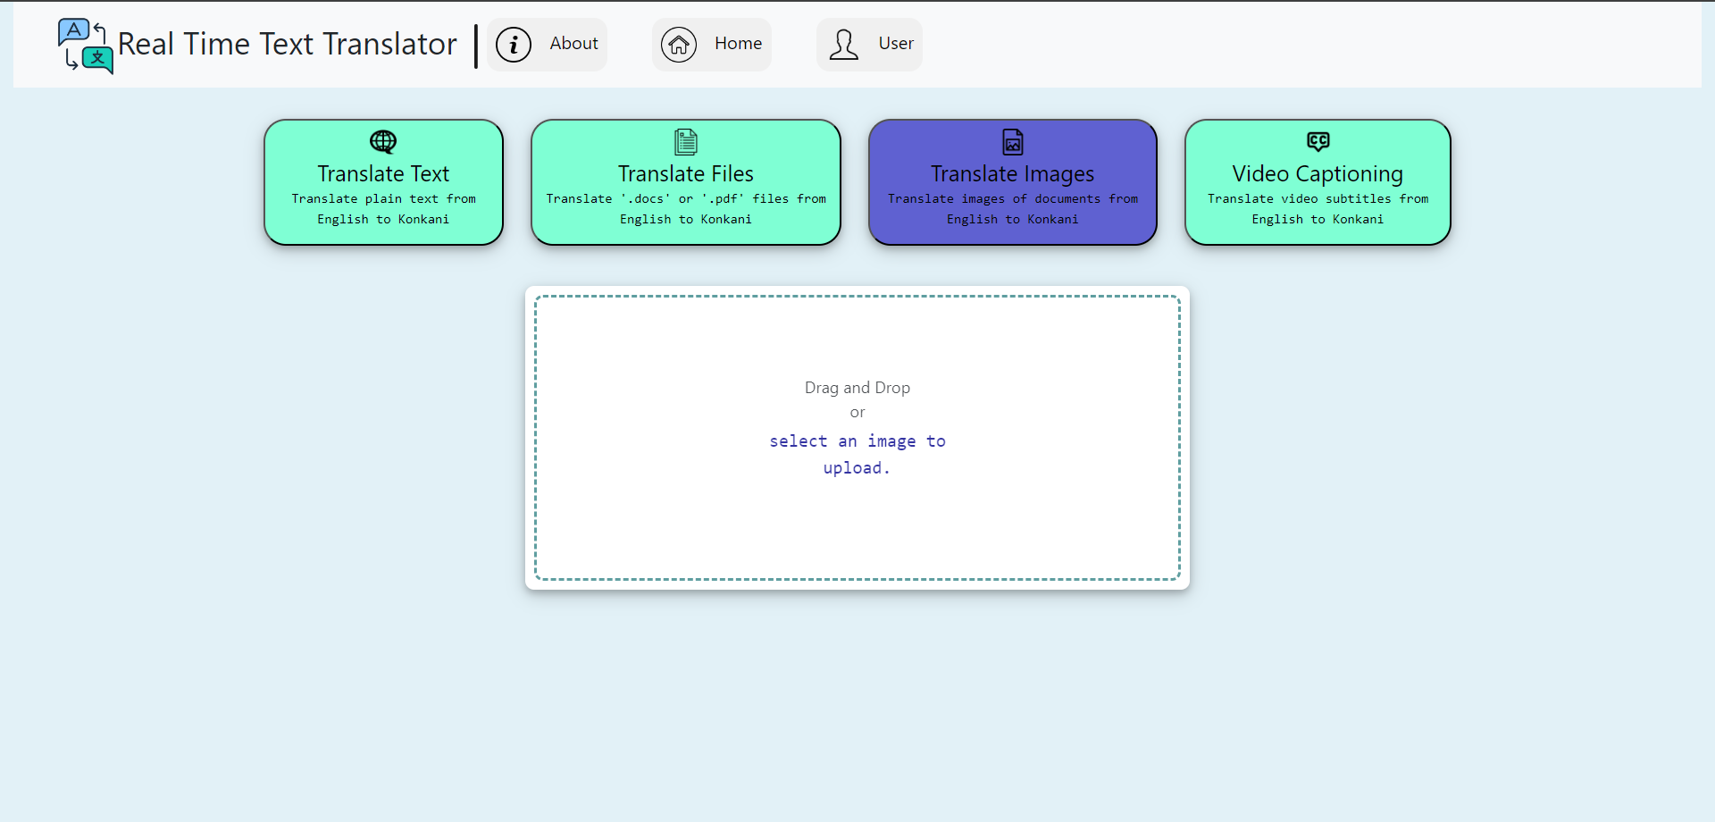
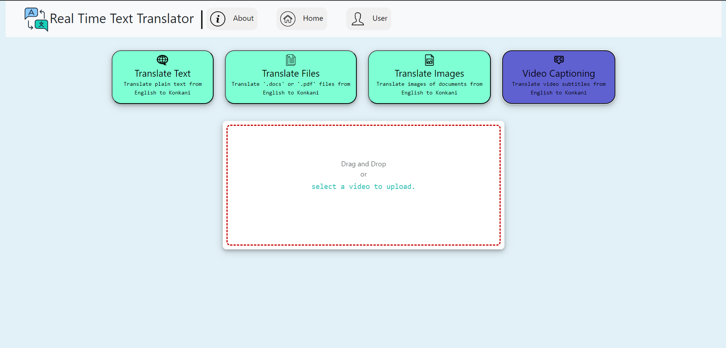

Slide 18
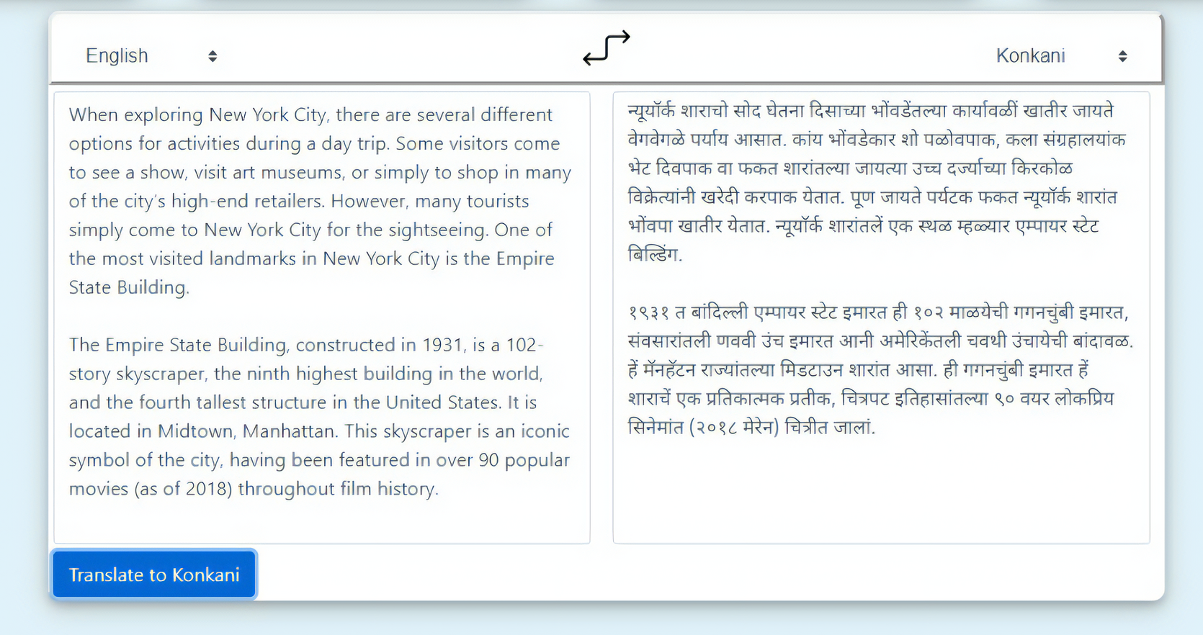
Text Translation (Example)

Slide 19
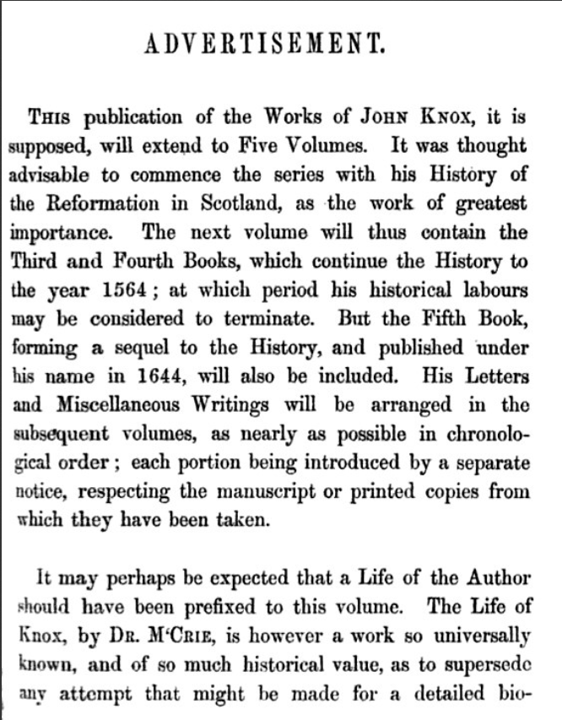
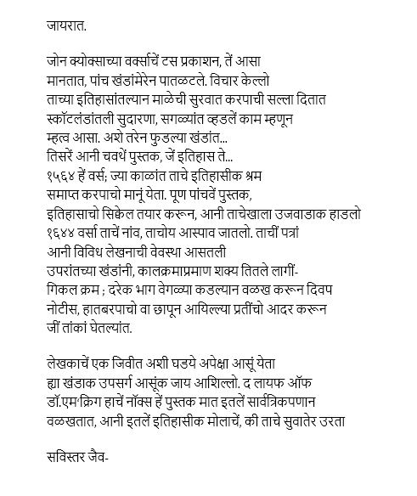
Image Translation (Example)

Slide 20
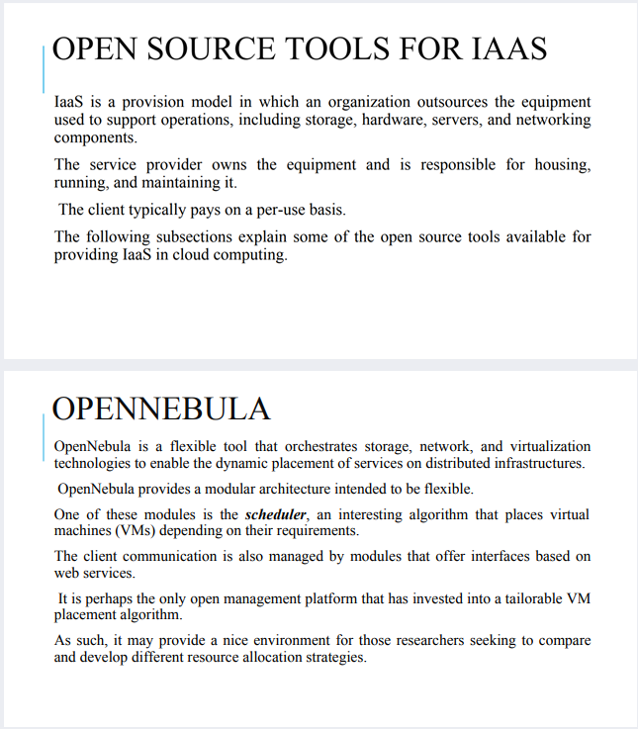
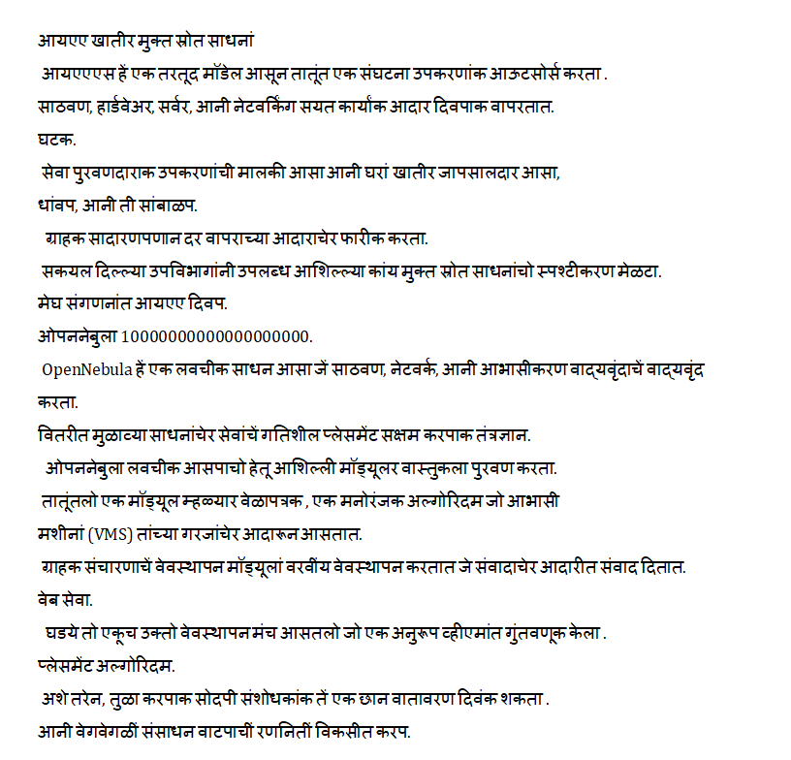
Document Translation (Example)

Slide 21
References
https://ieeexplore.ieee.org/document/7955307/ ( Handwritten Devanagari Numeral and Vowel Recognition using Invariant Moments )
https://ieeexplore.ieee.org/document/7807914 (KOP: An Opinion Mining System in Konkani )
https://ieeexplore.ieee.org/document/8821812 ( Konkani Script to Speech Conversion by Concatenation of recognized Hand written Konkani Text Using Neural Network )
https://ieeexplore.ieee.org/document/9077842 ( A Survey of Machine Translation Approaches for Konkani to English )
https://ieeexplore.ieee.org/document/8487620 (PARTS OF SPEECH TAGGING FOR KONKANI LANGUAGE)
https://media.geeksforgeeks.org/wp-content/uploads/20190530190230/General-working-of-OCR-3.jpg
https://aws.amazon.com/what-is/ocr/#:~:text=A%20simple%20OCR%20engine%20works,is%20called%20optical%20word%20recognition(What is OCR?)
https://www.pactranz.com/language-translation-process/

